Slide 1





MACHINE LEARNING PROJECT 1 - ADMISSION PREDICTION
GROUP-22
Rohit Bairwa - Nowrosjee Wadia College
Aditya Kadagala - TKRCET
Prashant Kumar - Atria Institute of Technology
Prajwal Mahanawar – PVG’S COET

Slide 2
Project-1
Prediction of Graduate Admissions from an Indian perspective.

Slide 3
Multiple linear Regression :
Multiple linear regression (MLR), also known simply as multiple regression, is a statistical
technique that uses several explanatory variables to predict the outcome of a response variable. The goal of multiple linear regression (MLR) is to model the linear relationship between the explanatory
(independent) variables and response (dependent) variable.

Slide 4
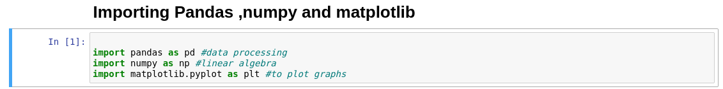
Step 1: Import the Useful libraries :
Pandas Libraries for handling data
Numpy for linear algebra
Matplotlib for ploting graph

Slide 5
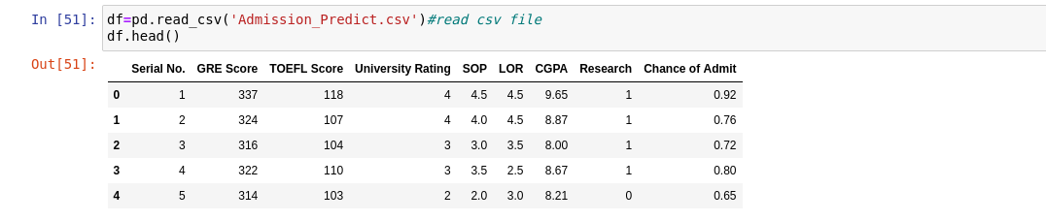
Step 2 :
Reading CSV file and printing in standard format

Slide 6
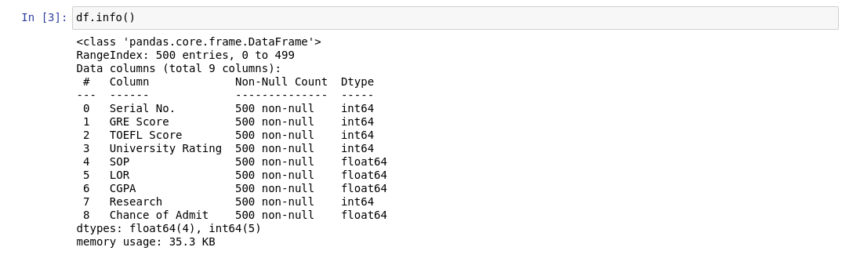
Step 3:
Checking Data types of all columns

Slide 7
Step 4:
Taking columns in x and y variable.

Slide 8
Step 5: Training data
Check shape of train data

Slide 9
Step 6: Importing LinearRegression from sklearn.learn_model
And Fitting train data.

Slide 10
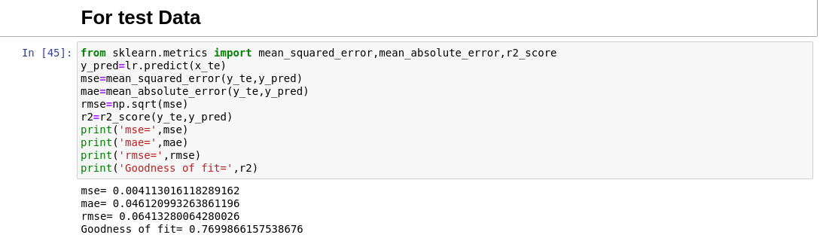
Step 7: Checking Accuracy of test data

Slide 11
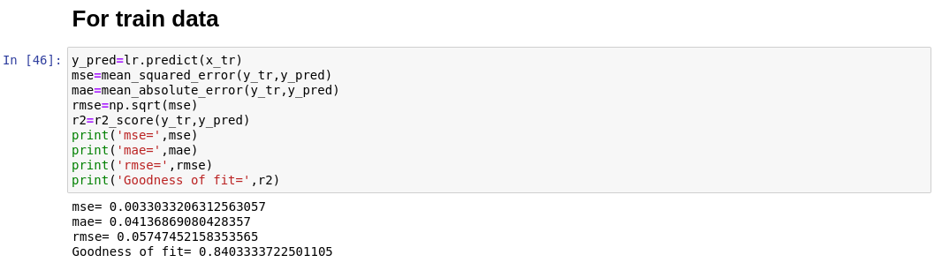
Step 8 :Checking accuracy for train data

Slide 12
After Comparing Accuracy for test and train ,we found that our model’s accuracy for train data is greater then the accuracy for test data.
Step 9: Plotting graphs using seaborn.

Slide 13
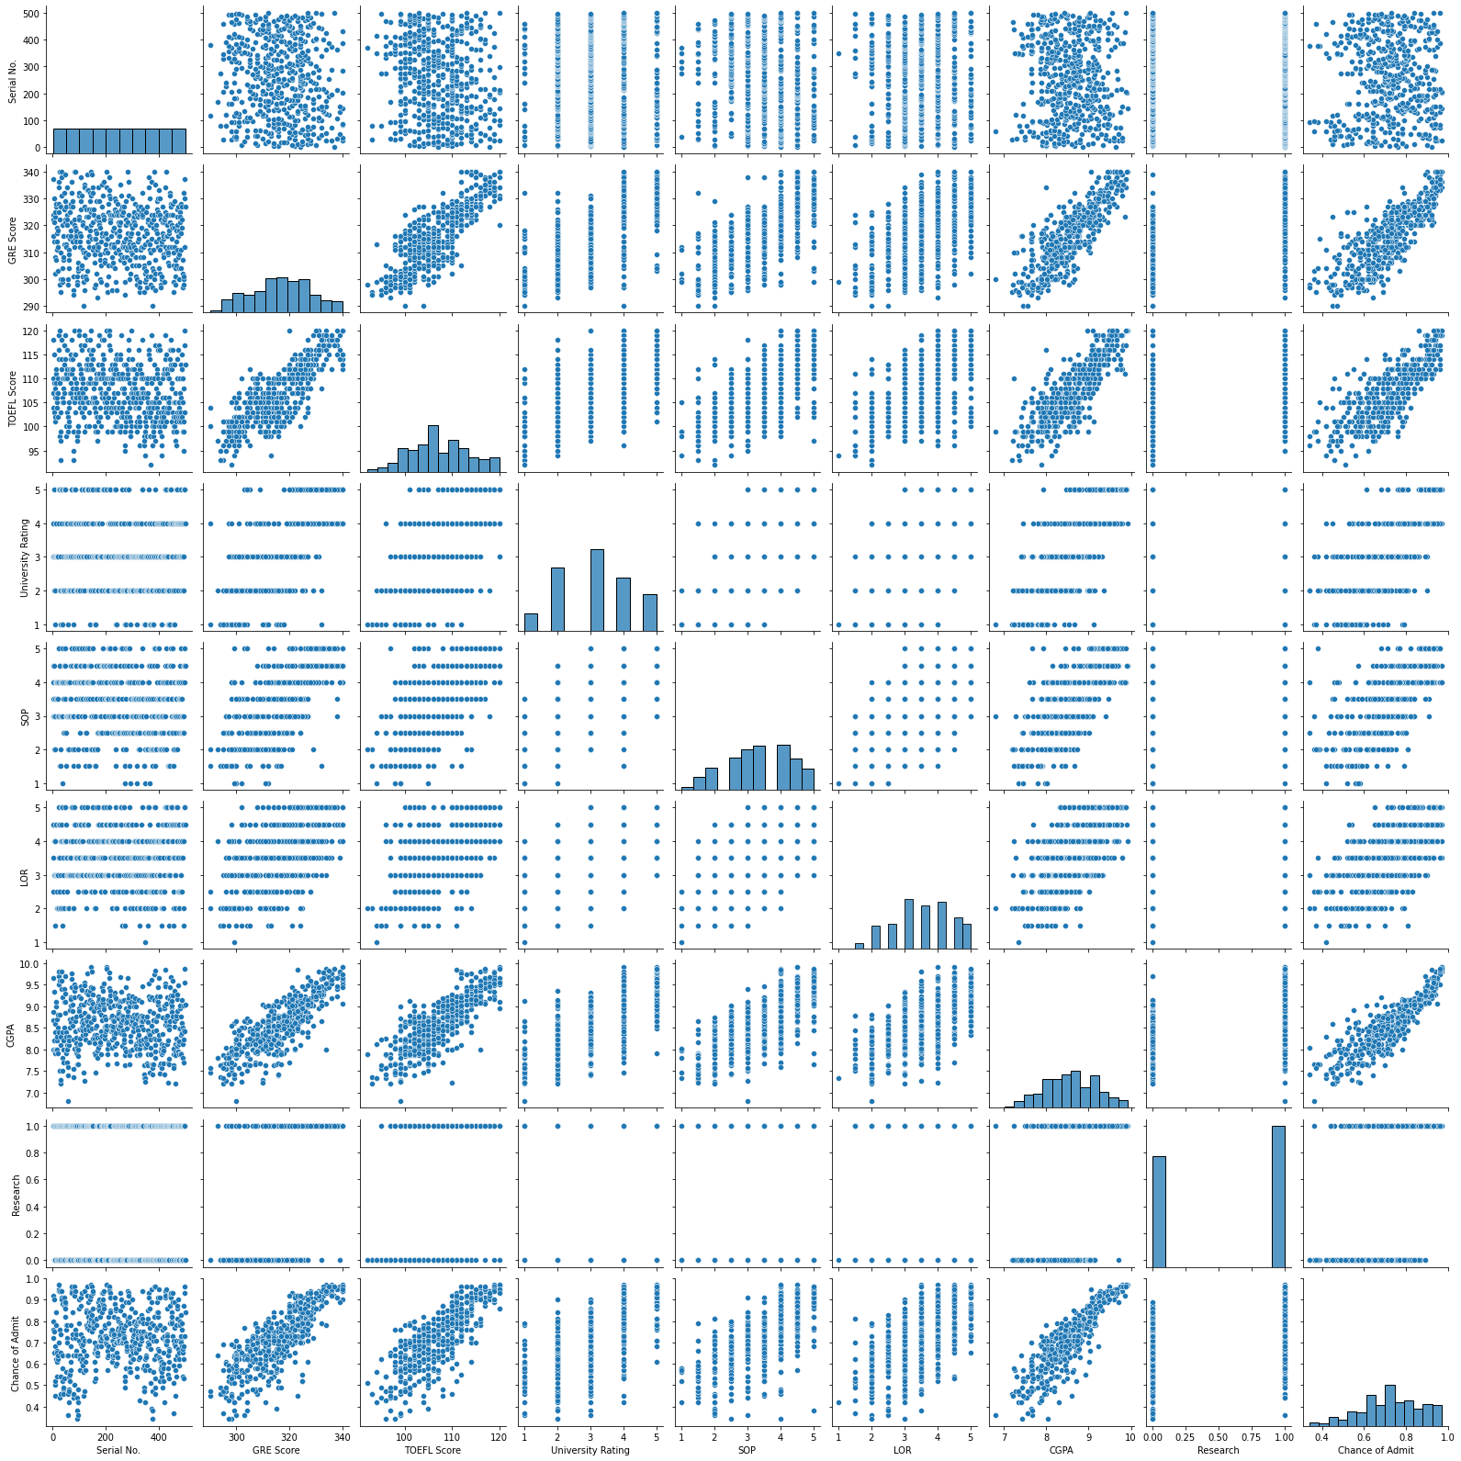

Slide 14
Step 10: Plotting Heat map

Slide 15
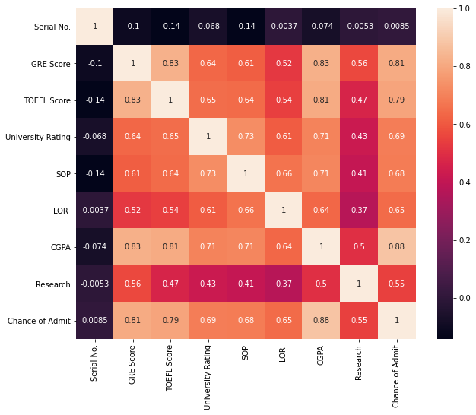

Slide 16
Multiple Linear Regression model using Principal Component Analysis Algorithm:
Step1) First we import the relevant libraries like pandas, numpy, sklearn, matplotlib, seaborn to our Jupyter notebook.
Step 2) Then we import the dataset (in our case, Admission_predict_ver1.csv).
Step 3) Allocate the features and the target to separate dataframes.
Step 4) Check the features and drop irrelevant features (serial_no).
Step 5) Standardize the features.
Step 6) Perform Dimensionality Reduction using Principal Component Analysis.
Step 7) Plot the PCA data.
Step 8) Divide the dataset into training set and testing set.
Step 9) Train the model using multiple linear regression.
Step 10) Test the model using the relevant evaluation metrics like R2_Score, RMSE, MAE.
Step 11) Try improving the R2_Score by performing standardization and various dimensionality reduction techniques.
Step 12) Plot the data.

Slide 17
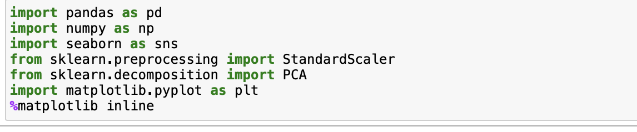
Step1) First we import the relevant libraries like pandas, numpy, sklearn, matplotlib, seaborn to our Jupyter notebook.

Slide 18
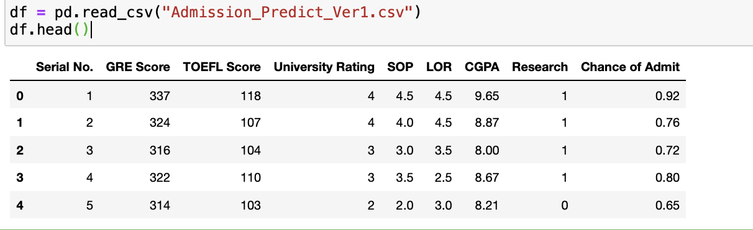
Step 2) Then we import the dataset (in our case, Admission_predict_ver1.csv).

Slide 19
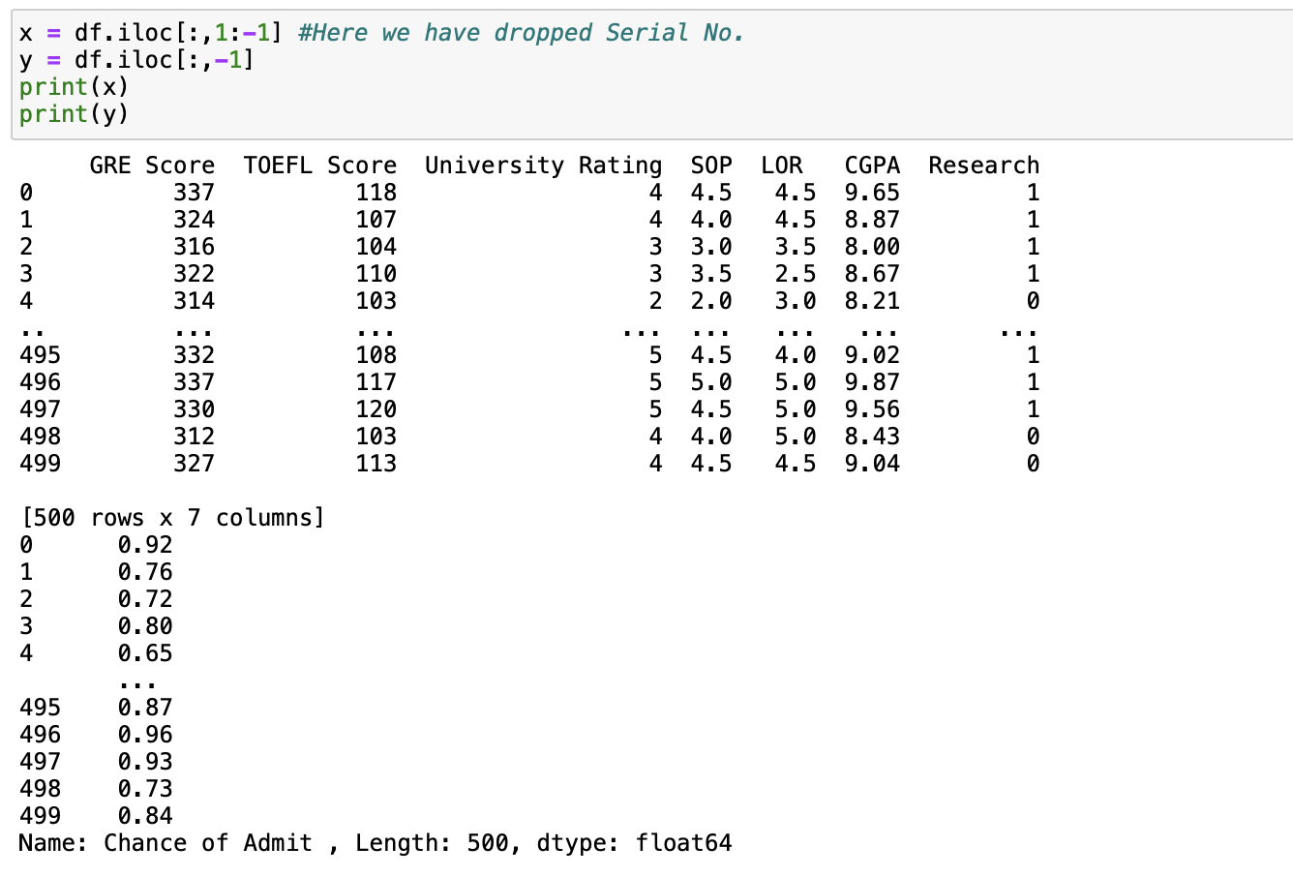
Step 3) Allocate the features and the target to separate dataframes.
Step 4) Check the features and drop irrelevant features (serial_no).

Slide 20
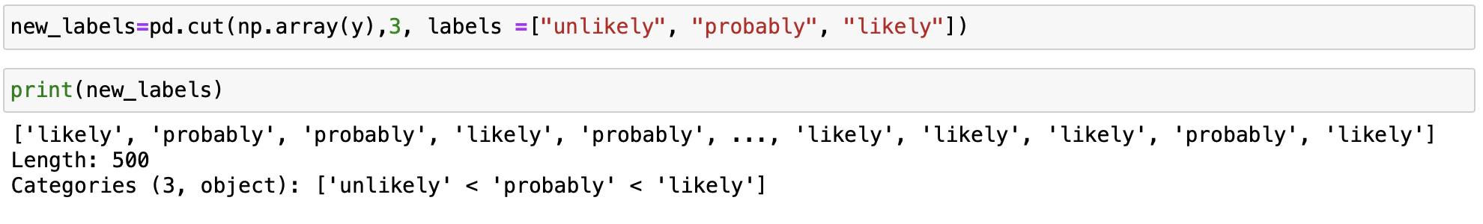
Step 4-i) Categorising the Chance of Admit

Slide 21
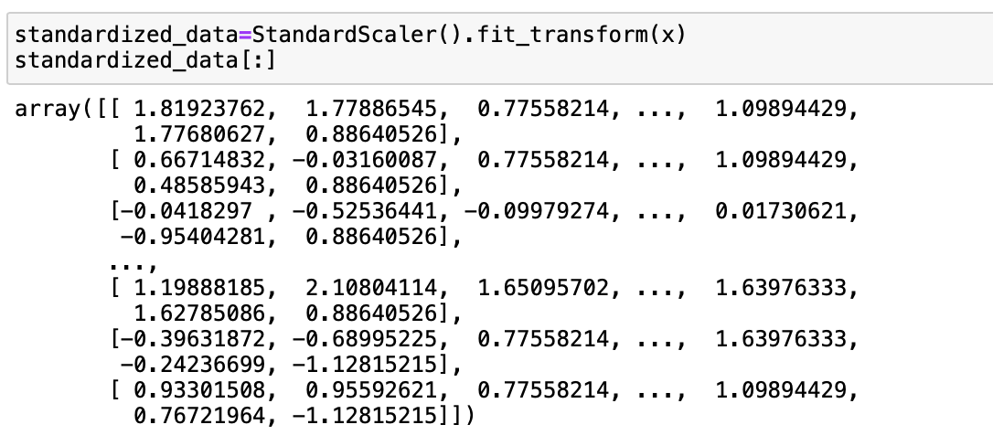
Step 5) Standardize the features

Slide 22
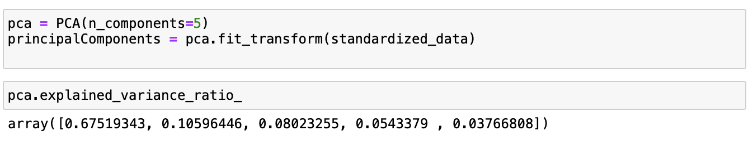
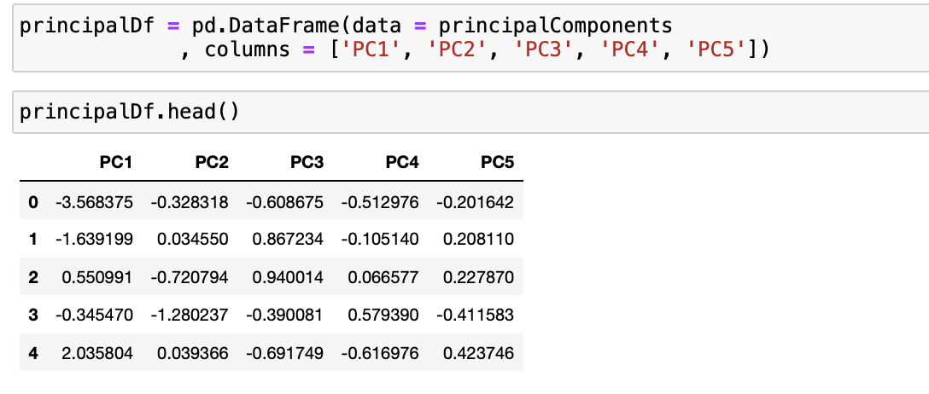
Step 6) Perform Dimensionality Reduction using Principal Component Analysis.

Slide 23
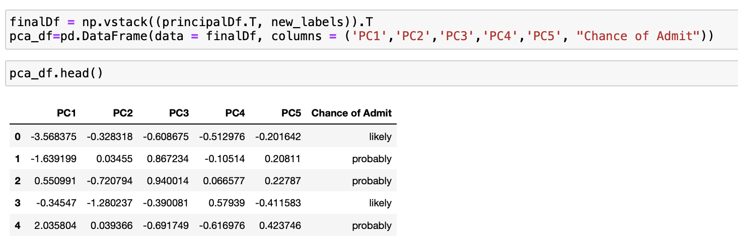
Step 6-i) Adding the target class to the PCA dataframe

Slide 24
Step 6-ii) Checking the Explained variance ratio

Slide 25
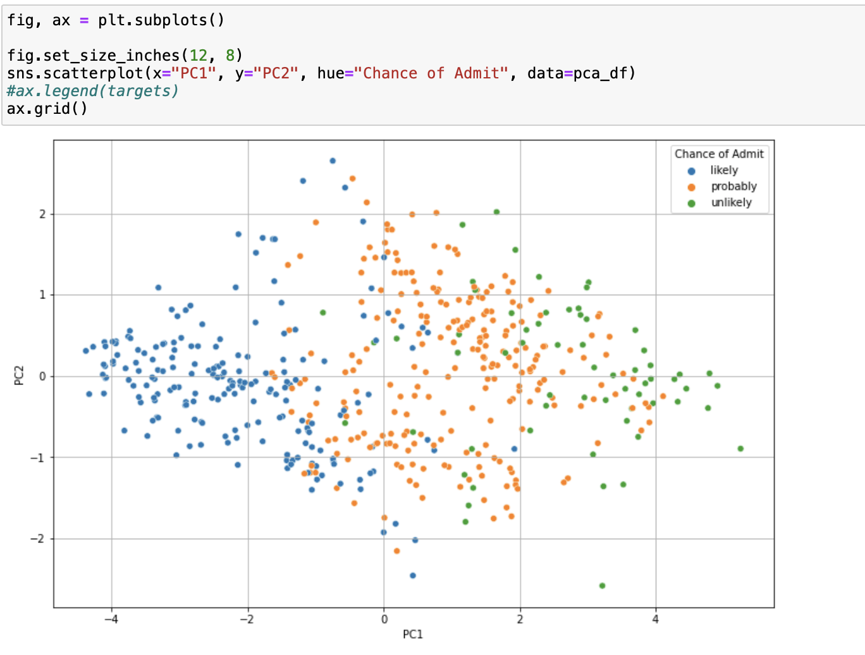
Step 7) Plot the PCA data.

Slide 26
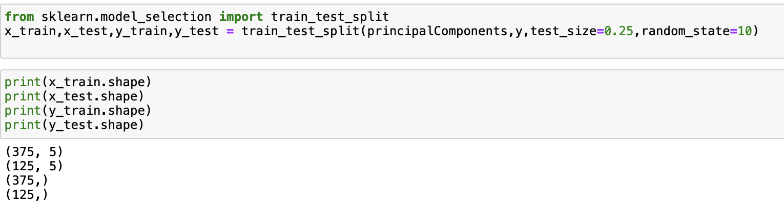
Step 8) Divide the dataset into training set and testing set.

Slide 27
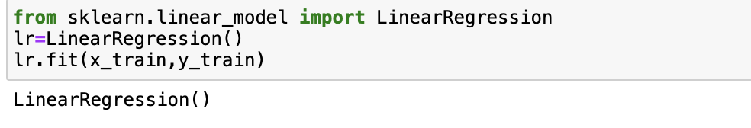
Step 9) Train the model using multiple linear regression.

Slide 28
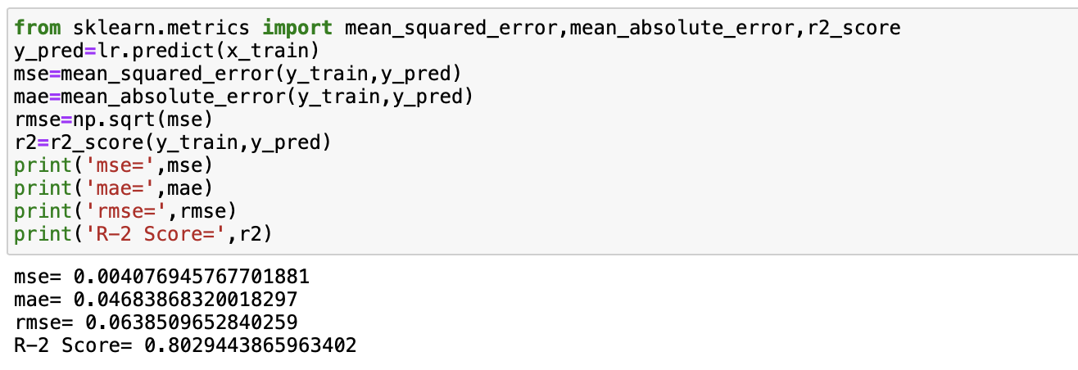
Step 10) Test the model using the relevant evaluation metrics like R2_Score, RMSE, MAE.
Training data

Slide 29
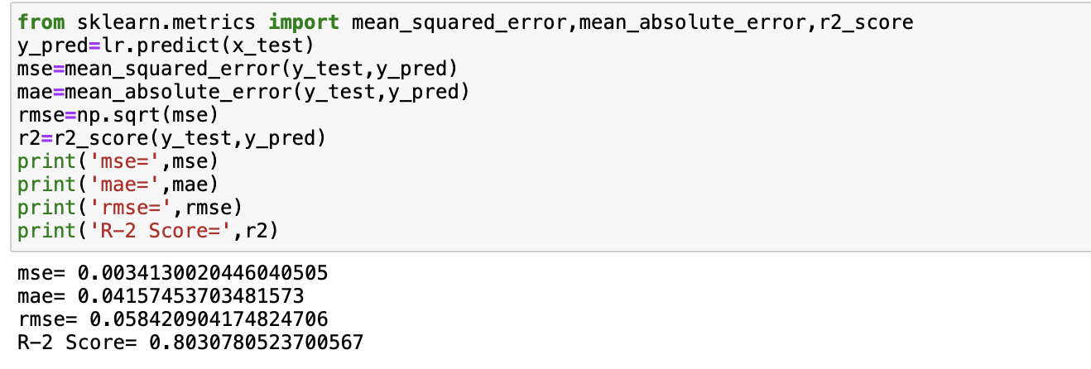
Testing Data

Slide 30
Random Forest Regression:
Random Forest Regression is a supervised learning algorithm that uses ensemble learning method for regression. Ensemble learning method is a technique that combines predictions from multiple machine learning algorithms to make a more accurate prediction than a single model.

Slide 31
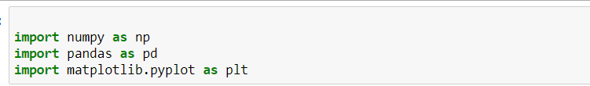
Step 1: Importing the Python Libraries:

Slide 32
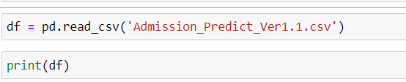
Step 2: Importing the dataset and printing it:

Slide 33

Step 3 :Checking Data types of all columns

Slide 34
Step 4: Taking values of columns in x and y variable

Slide 35
Step 5:Training the data

Slide 36
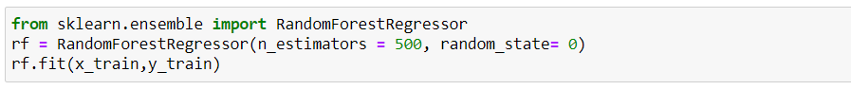
Step 6: Creating a Random Forest Regression model and fitting it to the training data

Slide 37
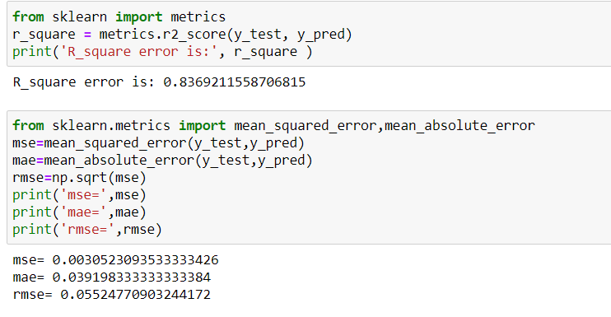
Step 7: Predict the minimum MSE,MAE and RMSE and maximum R-Square score

Slide 38
Step 8: Importing the digits dataset

Slide 39
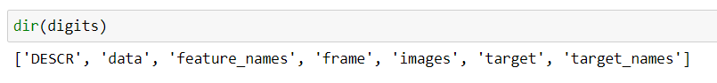
Step 9: Using dir() function

Slide 40
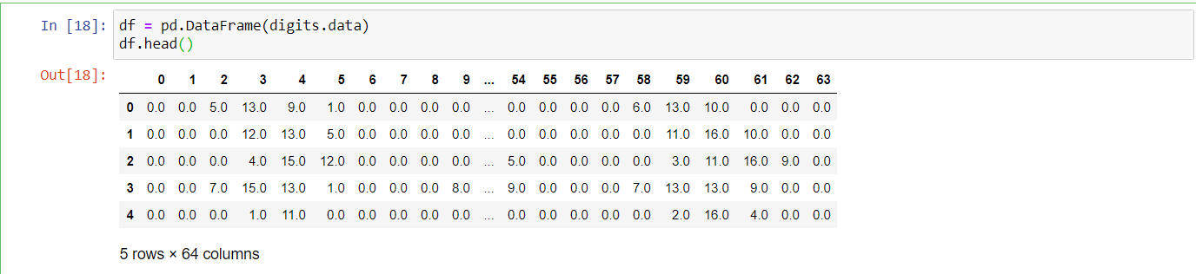
Step 10 : Creating the pandas data frame using digits dataset

Slide 41
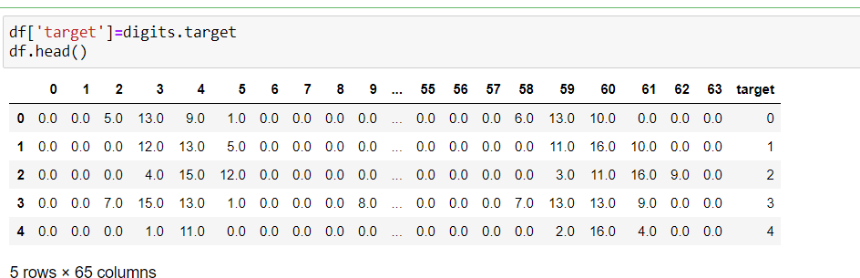
Step 11:Appending the target column into the data frame

Slide 42
Step 12: Training the data set

Slide 43
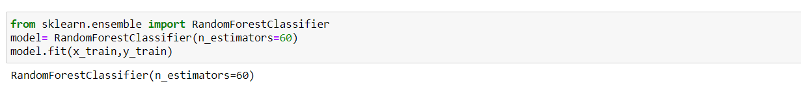
Step 12: Creating a Random Forest Classifier and fitting into the training data

Slide 44
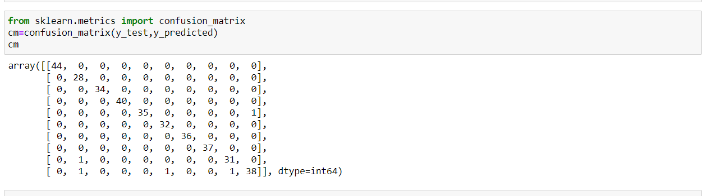
Step 13: Using the confusion matrix for ploting

Slide 45
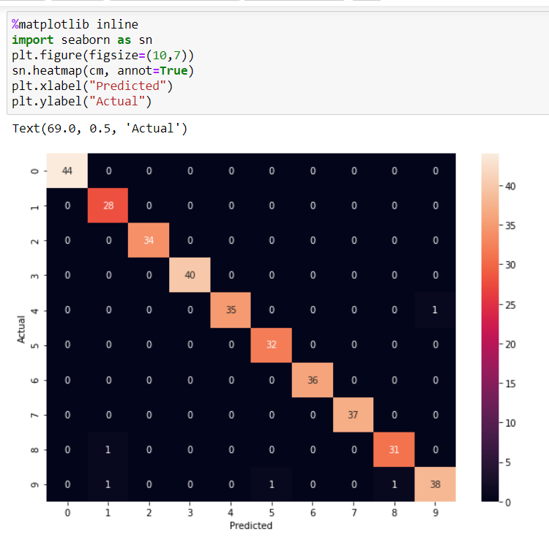
Step 14: Plotting the heat map

Slide 46
RANDOM FOREST USING PCA
RANDOM FOREST :
Random Forest Regression is a supervised learning algorithm that uses ensemble learning method for regression.
A Random Forest operates by constructing several decision trees during training time and outputting the mean of the classes as the prediction of all the trees.
PRINCIPAL COMPONENT ANALYSIS(PCA):
PCA performs dimensionality reduction, which can reduce the number of features for the Random Forest to process, so PCA might help speed up the training of your Random Forest model.

Slide 47
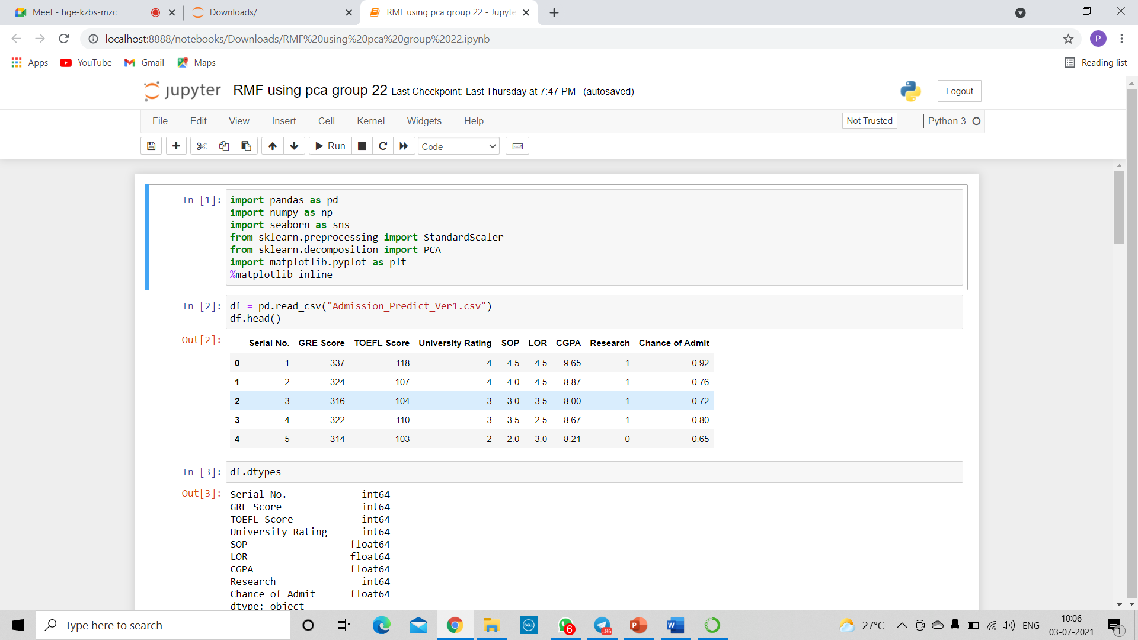
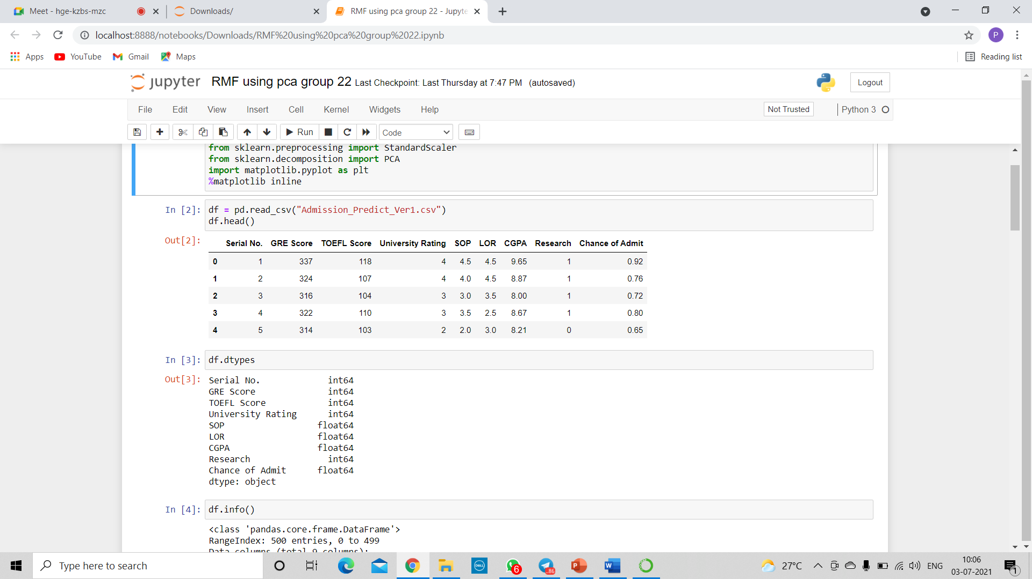
RANDOM FOREST USING PCA MODEL:
#1 Importing important libraries used for the model.
#2 Reading the given data set and loading into pandas data frame.

Slide 48
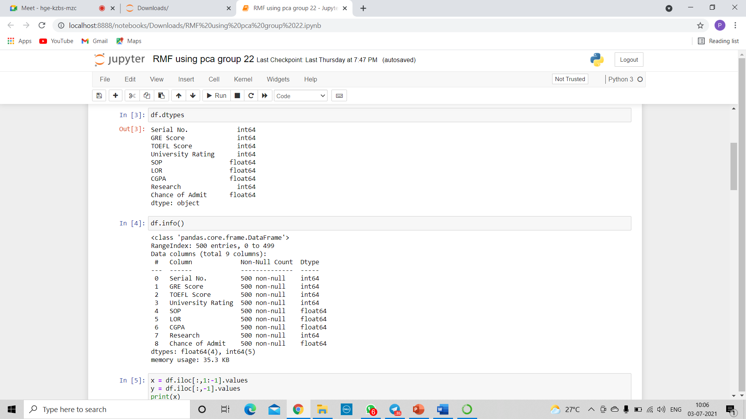
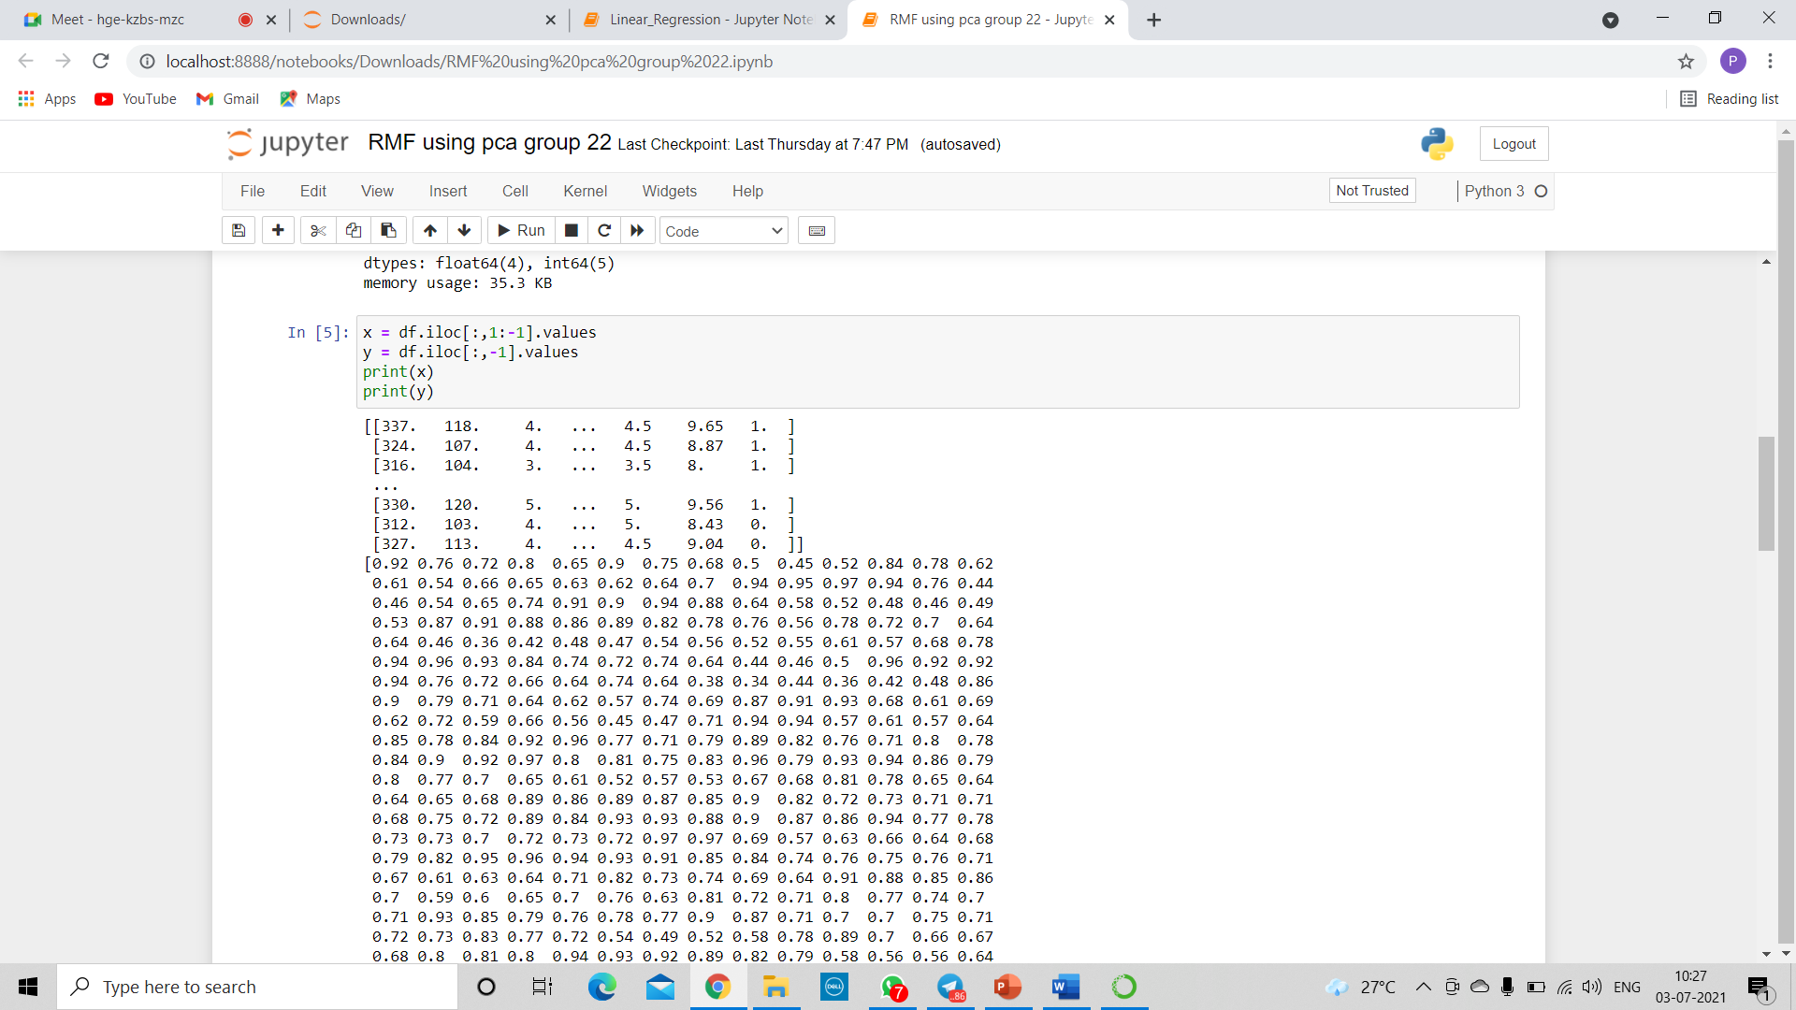
#3 checking data type and if it has any null values.
#4 separating out the features.

Slide 49
#5 Splitting the dataset into training and testing
#6 scale the data
Before modeling, we need to “center” and “standardize” our data by scaling. We scale to control for the fact that different variables are measured on different scales.

Slide 50
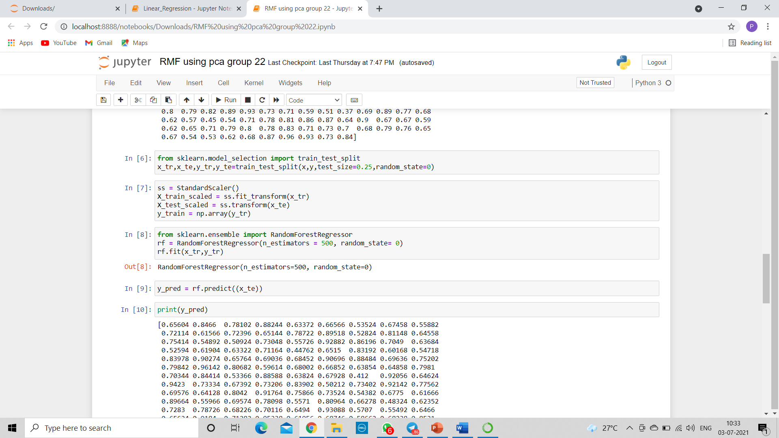
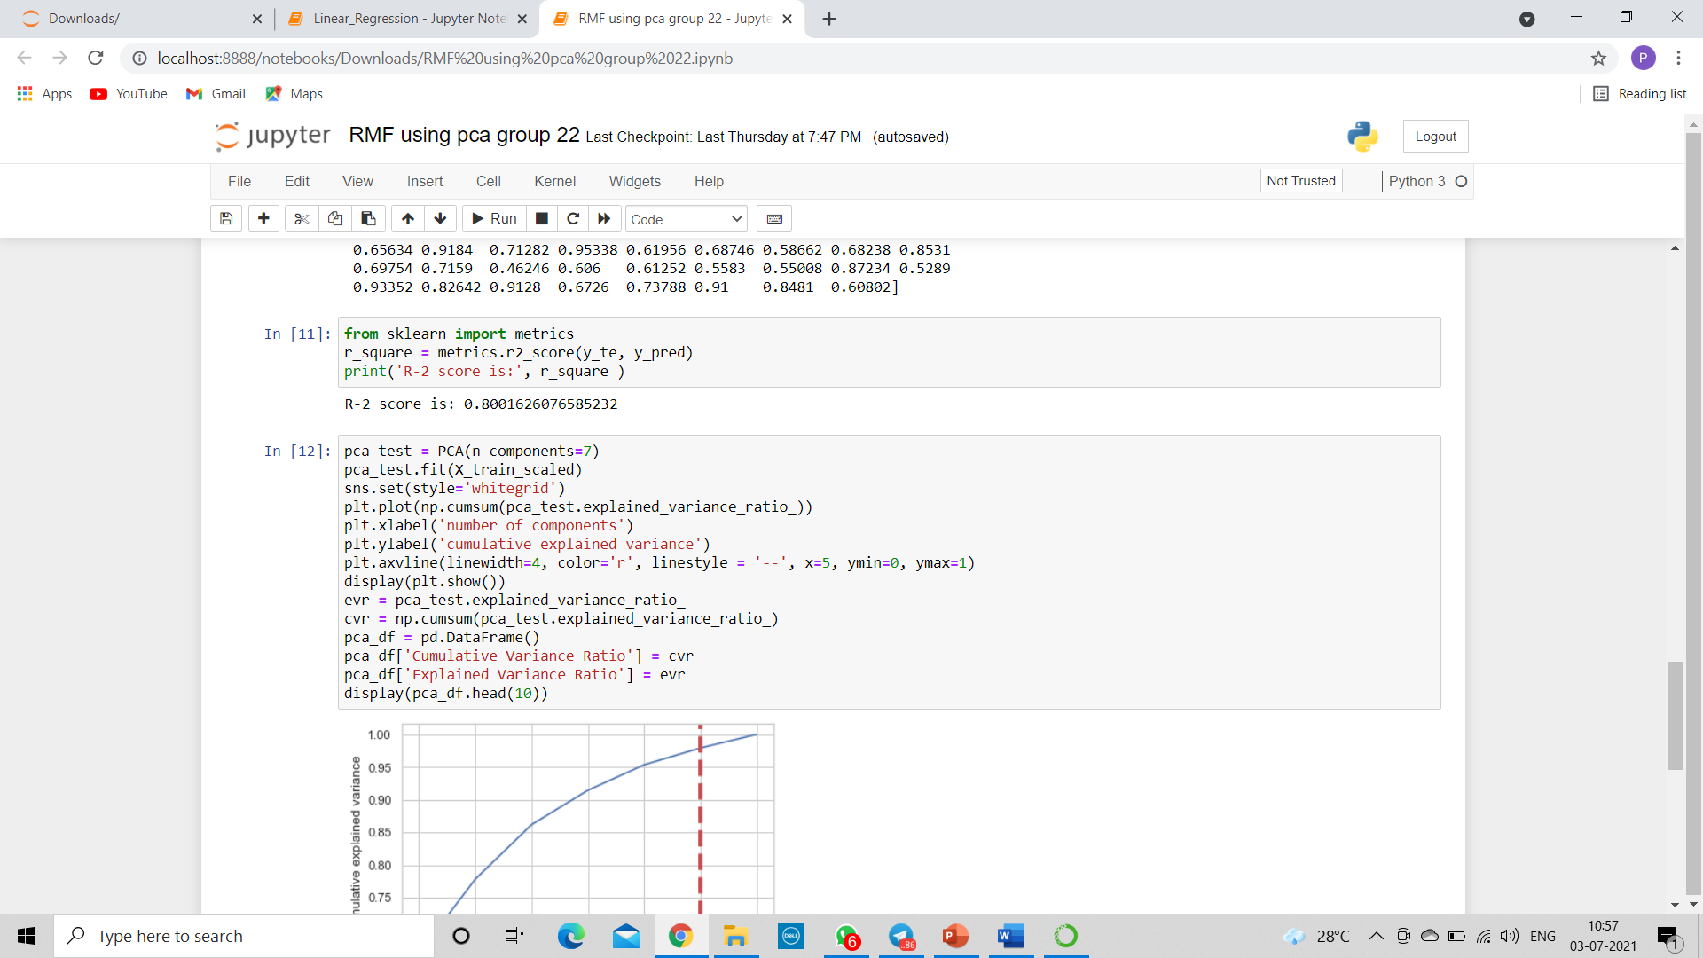
#7 Building the random forest Regression Model
The parameter n_estimators creates n number of trees in your random forest, where n is the number you pass in.
#8 evaluating the model

Slide 51
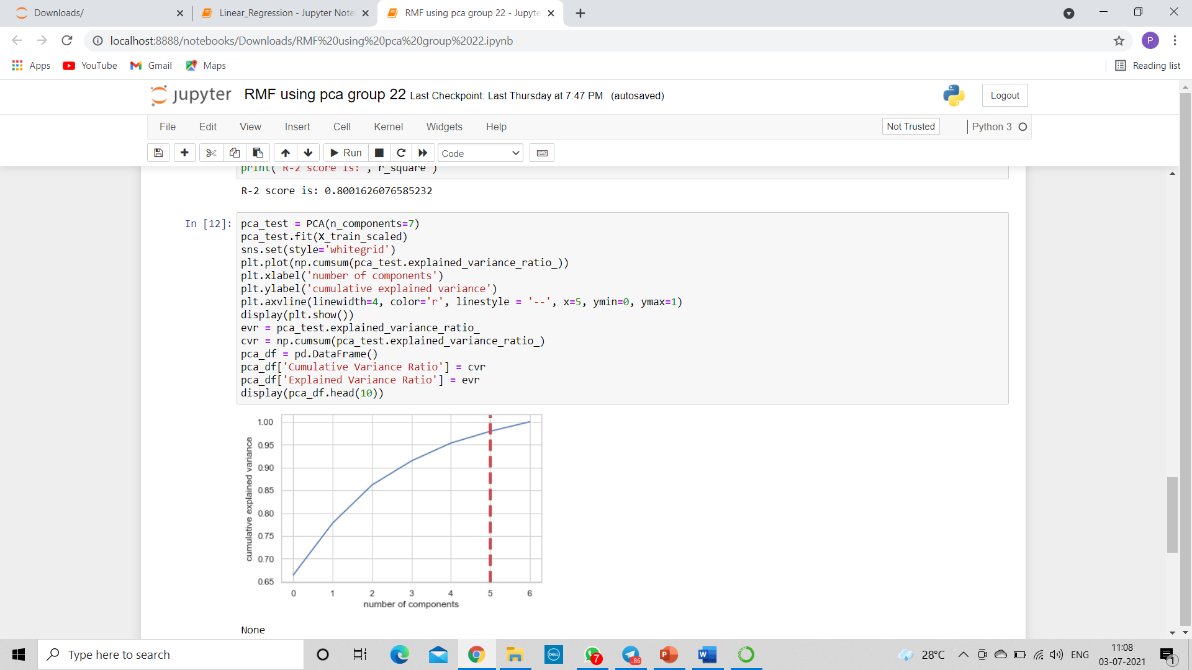
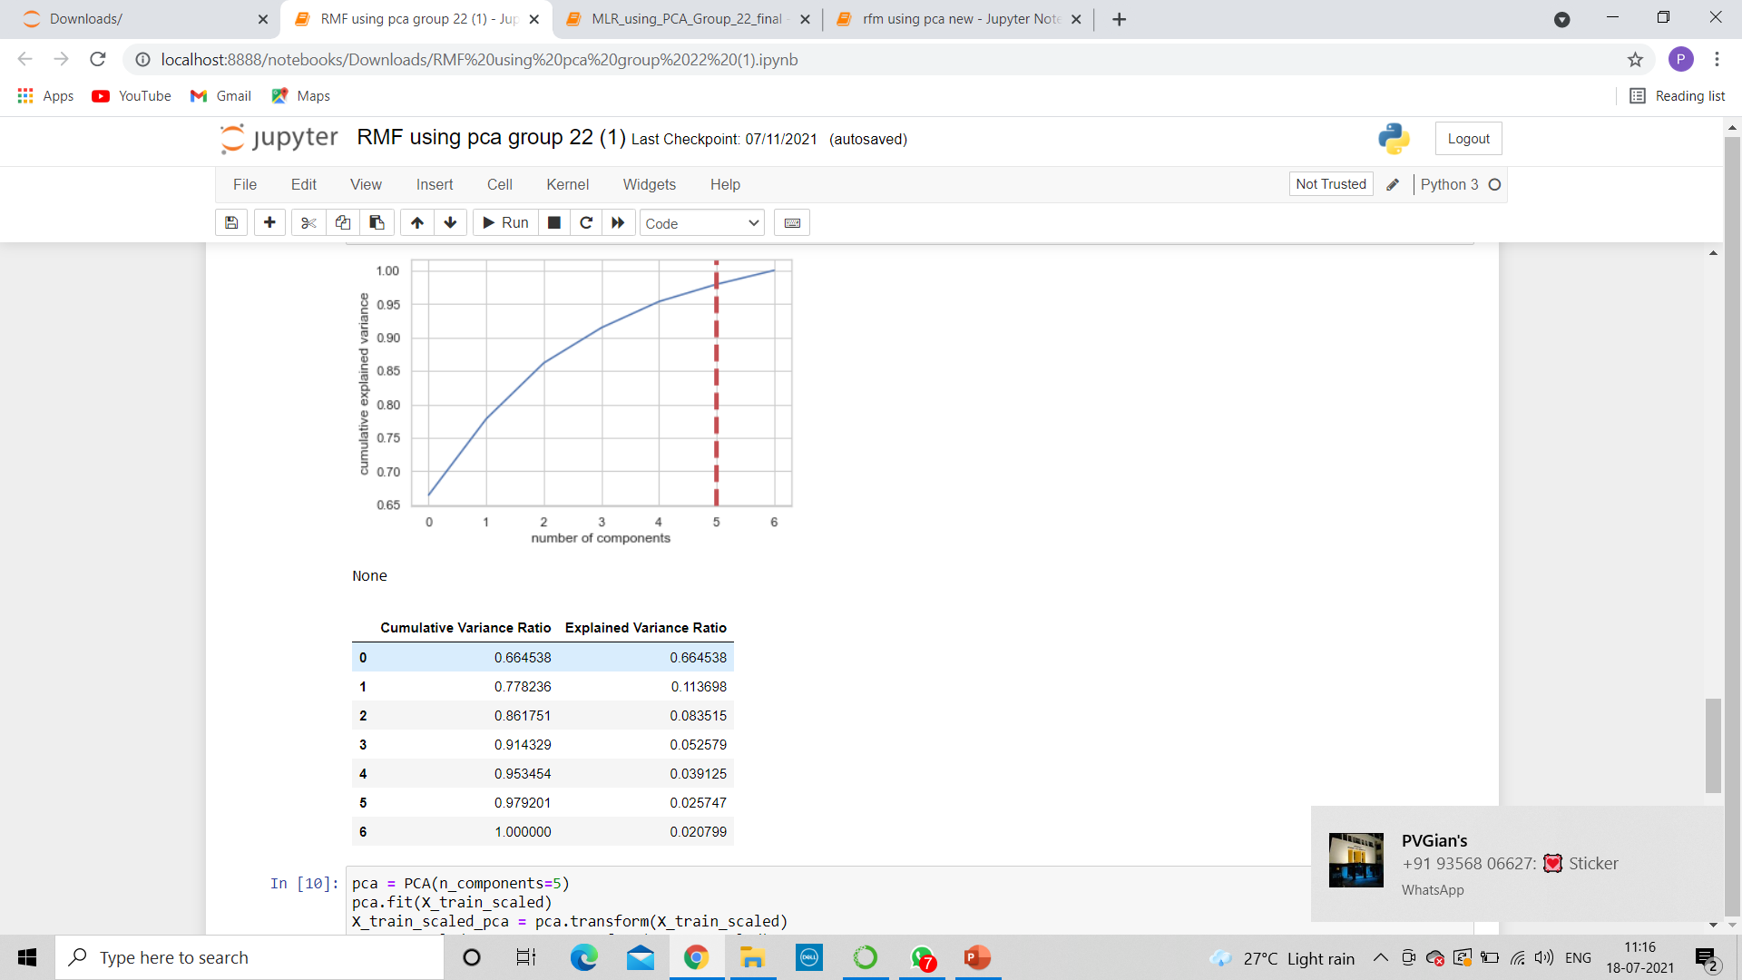
#9 plotting the graph of explained and cumulative variance ratio to get an idea about how much data should be cut performing pca so there would be minimal loss of data by using the graph.
graph shows that after more than 5 components, we don’t gain very much variation in variance.

Slide 52
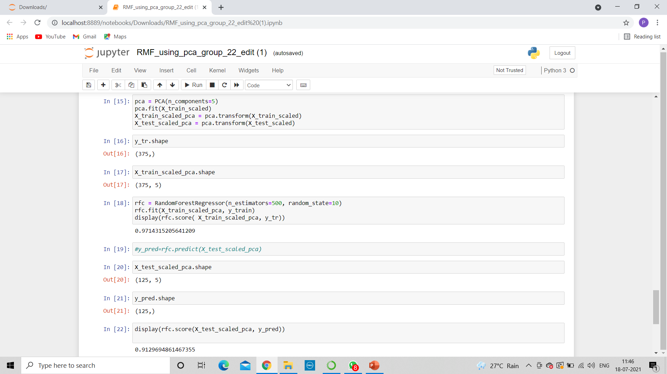
#10 Determining principal components and then using random forest in it to get the random forest score using pca.

Slide 53
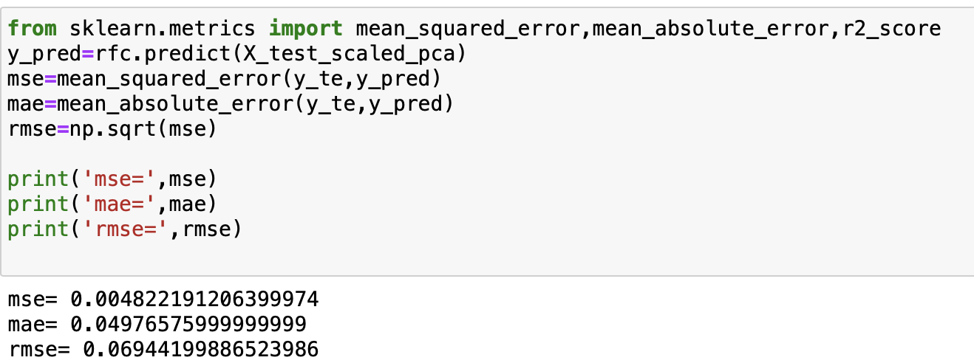
#11 Other Evaluation metrics:

Slide 54
Conclusion
The subject of this project was to determine if the variables contribute to the admission of student to Master’s degree program with the help of prediction models. The results of this examination appear to indicate that it greatly contributes to the response variable ‘Chance of Admit’. Higher the GRE, TOEFL, score then higher the admit chances.
The model predicts 84% accuracy with multiple linear regression , 80% accuracy using multiple linear regression using PCA, 83% accuracy with random forest model and 91% accuracy with Random Forest model using PCA and can be used for predicting the admit chances based on the above factors. This model will be helpful for the universities to predict the admission and ease their process of selection and timelines.
As part of the hypothesis, the model proved that admission to Master’s degree program is dependent on GRE, TOEFL and other scores.
The results observed are that the R2_Score is high for Random Forest using PCA model while multiple regression model performed moderately. This implies using Random Forest, we can predict better whether a student gets admission or not.

Slide 55
Thank you
Batch_16_Group_22

